Slide 1
Installing NodeJS

Slide 2
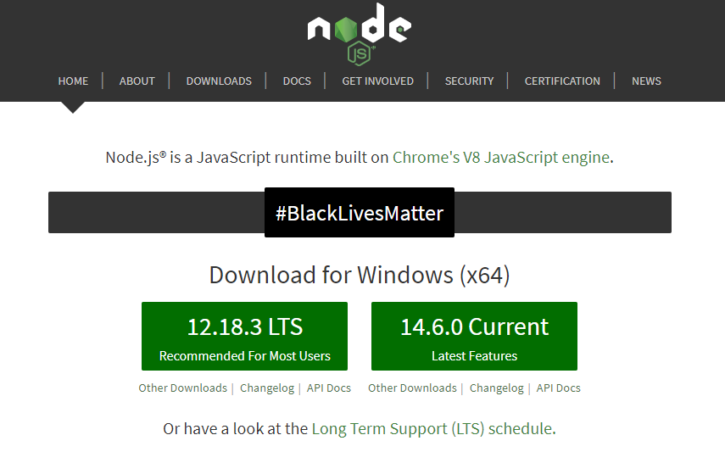
Installing NodeJS
Another core tool we’ll be using in this course is NodeJS.
Install NodeJS by navigating to https://nodejs.org and selecting the current version

Slide 3
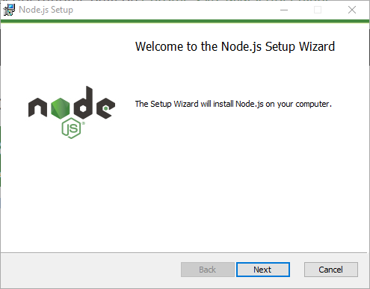
Installing NodeJS (continued)

Slide 4
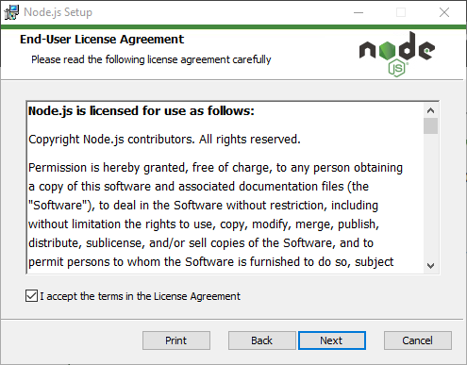
Installing NodeJS (continued)

Slide 5
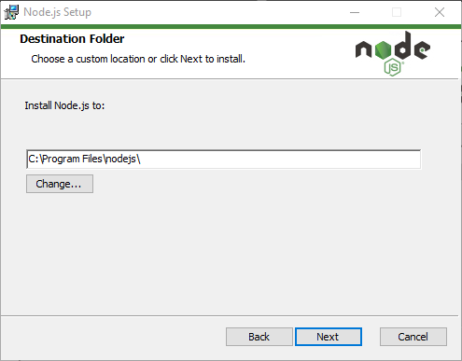
Installing NodeJS (continued)

Slide 6
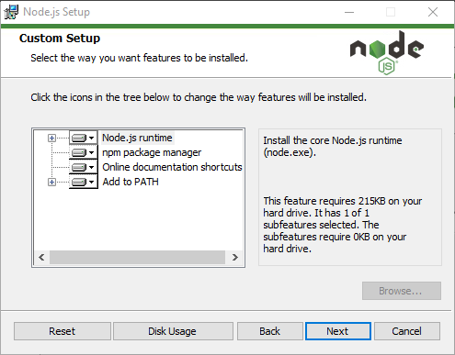
Installing NodeJS (continued)

Slide 7
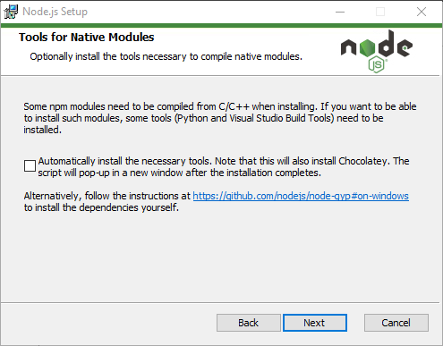
Installing NodeJS (continued)

Slide 8
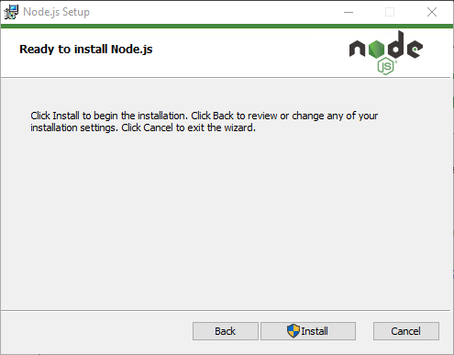
Installing NodeJS (continued)

Slide 9
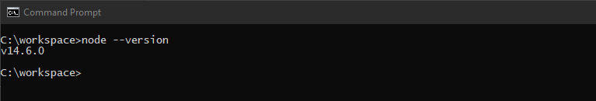
Installing NodeJS (continued)
Verify your installation by opening a command prompt.
Enter the command: node --version and press enter.

